Slide 1
HDFS Assessment Transition Supplier Communication

Slide 2
Transition from HDFS to Third Party Financial Assessments
As of May 1, 2013, HDFS will no longer provide financial viability assessments.
Harley-Davidson has contracted a third party, Rapid Ratings, to provide assessments.
Rapid Ratings will provide better analysis across a wider variety of industries.
Rapid Ratings will also provide a better comparison of suppliers against their peers outside of our supply base.

Slide 3
Rapid Ratings Background
Rapid Ratings is an independent assessor of supplier financial health.
Rapid Ratings has been providing financial assessments for seven years across 24 different industries.
Rapid Ratings offers a level of analysis and industry knowledge that HDFS cannot.

Slide 4
Confidentiality
Rapid Ratings will provide the same level of privacy as HDFS.
Supplier financial data will NOT be shared with anyone at Harley-Davidson.
Supplier financial data will NOT be shared with any other Rapid Ratings client.
Rapid Ratings will sign a confidentiality agreement with any supplier upon request.

Slide 5
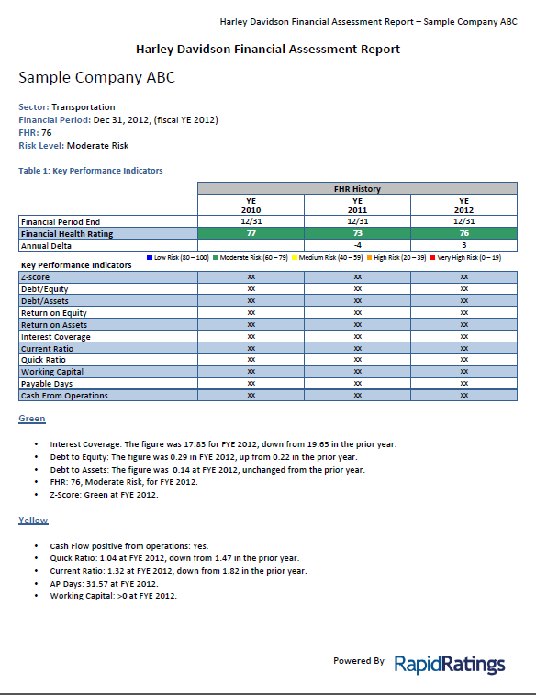
Financial Health Report
Rapid Ratings will supply Harley-Davidson with a customized report similar to previous HDFS reports.
The report contains only ratios – no “hard” numbers.

Slide 6
Other Information Available to H-D
Upon request, Rapid Ratings will supply Harley-Davidson with a “Non-Financial” report.
The Non-Financial report includes commentary from Rapid Ratings comparing supplier to industry averages.
The Non-Financial report will not be available to suppliers.

Slide 7
Example of Non-Financial Report

Slide 8
Process for Suppliers to Request Assessment Feedback from Harley-Davidson
Requests for feedback on the assessments can be made to John Dolezal:
John Dolezal
Materials Cost Analyst, Sr.
Harley-Davidson Motor Company
11800 W. Capitol Drive
Wauwatosa, WI 53222
Tel: 414-465-6208
Cell: 414-349-6320
Email: john.dolezal@harley-davidson.com

Slide 9
How Does this Process Look Different to You?
Rapid Ratings will request your company’s Balance Sheet and Income Statement for the prior two year annual periods. In subsequent years, they will only need the most recent year-end statements.
Rapid Ratings will request your NAICS Code.
Financials will be emailed to Rapid Ratings:
harley-davidson@rapidratings.com

